Slide 1

Windows directory structure
Telerik Software Academy
academy.telerik.com
Borislav Varadinov
Marian Marinov
System Administrator
CEO of 1H Ltd.
bobi@itp.bg
mm@1h.com

Slide 2

Table of Contents
Windows drive letters
Windows and System32
Program Files
Recycle Bin
Users
System Volume Information

Slide 3
Windows drive letter. Why C:\ !
Root Directory:
C:\
C:\Users
C:\Windows
C:\Users\Bobi
C:\Users\Мариян
Windows uses the conception of drive letters
Alphabetical identifiers to physical or logical device
You can use echo %systemdrive% to check your system drive

Slide 4
Windows and System32
Most of the files associated with the Windows operating system might be found in these folders
Usually C:\Windows and C:\Windows\System32
System32 folder contains many core system files (e.g .exe and .dll) and drivers
You can use echo %windir% to check where is placed the windows directory

Slide 5
Program Files
Program Files and Program Files (x86)
Keep applications that are not part of the operating system
Default installation paths
Each program is put into its own subdirectory
In the modern Windows versions the applications store their user related data and temp files in the user profile

Slide 6

Users
%SystemDrive%\Users contains users profiles and users data
Each user has own profile directory
You can use echo %userprofile% to check your profile path

Slide 7
User Profiles
Each user profile contains the following virtual folders
AppData/Application Data
My Documents, My Music, My Pictures, My Videos
Desktop
Favorites
Downloads
Every user has a private registry hive, maintained in its user profile - NTUSER.DAT
Notes:
AppData folder contains many user temporary and permanent data. Also it contains settings (e.g Start Menu objects - C:\Users\USERNAME\AppData\Roaming\Microsoft\Windows\Start Menu\Programs)

Slide 8
Configuration Manager (The Registry)
The registry is the system configuration database:
Required to boot and configure the system
Contains system-wide software settings
Contains the security database
Contains per-user configuration settings
Organised to “hives”
Pieces of the registry database stored in different files
It is also a window into in-memory volatile data:
The current hardware state of the system
Windows performance counters

Slide 9

Recycle Bin
$Recycle.Bin
Temporary storage for files that have been deleted by users
But not yet permanently removed from the file system
Each user has own recycle directory
C:\$Recycle.Bin\S-1-5-21-XXXXX

Slide 10


Recovery
C:\Recovery is a system reserved directory used by Windows RE
Recovery Environment started when selecting F8 from the boot options screen “Repair my Computer”
Windows Recovery Environment (Windows RE) is an extensible recovery platform. When the computer fails to start, Windows automatically fails over into this environment and the Startup Repair tool.

Slide 11
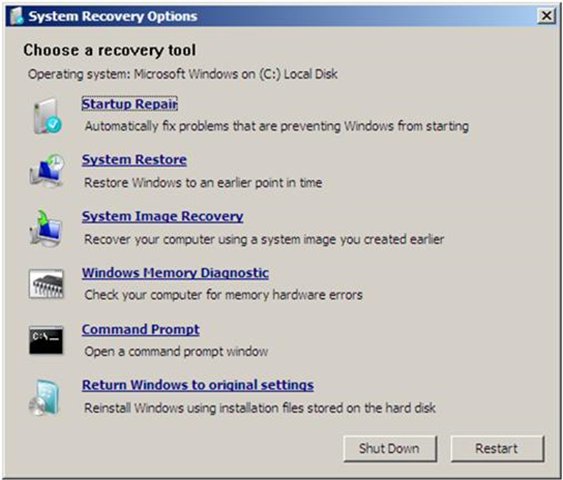
Windows Recovery

Slide 12
System Volume Information
System Volume Information is a system reserved space on a volume used for storing some system specific data.
The most common services that use it are:
System Restore information on client OS
Volume Shadow Service
Indexing Service and Windows Search

Slide 13
Windows Directory Structure
http://academy.telerik.com

Slide 14




Free Trainings @ Telerik Academy
"Web Design with HTML 5, CSS 3 and JavaScript" course @ Telerik Academy
html5course.telerik.com
Telerik Software Academy
academy.telerik.com
Telerik Academy @ Facebook
facebook.com/TelerikAcademy
Telerik Software Academy Forums
forums.academy.telerik.com

